Slide 1
Micro-Credit Defaulter Project
Machine Learning
BY:- Ayush Pathak

Slide 2
Problem Statement:
Telecom Industry
MFI is an organization which provides financial services to low income groups.
They provide the micro credit
These credits to be paid back in 5 days otherwise he or she is a defaulters.
There are two loan amount : 5 and 10 Indonesian Rupiah which is having a pay back amount of 6 and 12 Rupiah

Slide 3
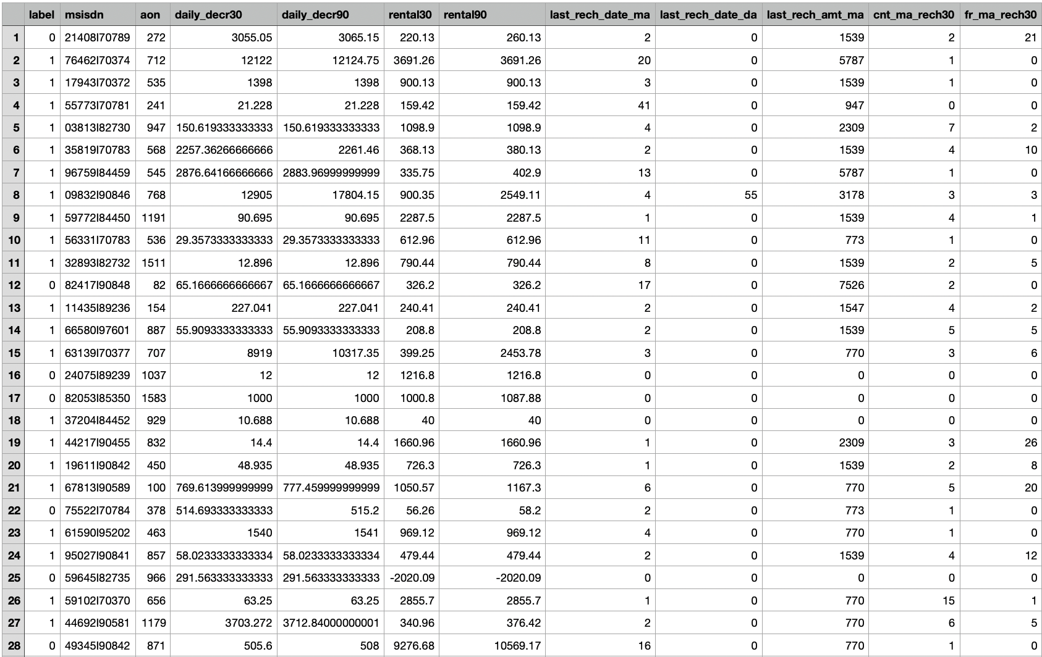
Dataset
No null values
Target variable is Non Defaulters = 87.98% records , Defaulters =12.01% records.
Data types are int64(12), object(1), float(21), datetime64(1).

Slide 4
Data Cleaning Steps:
Negative dataset remove
Dropping columns
Checking Missing Values
Applying z score on outliers
Handling skewness

Slide 5
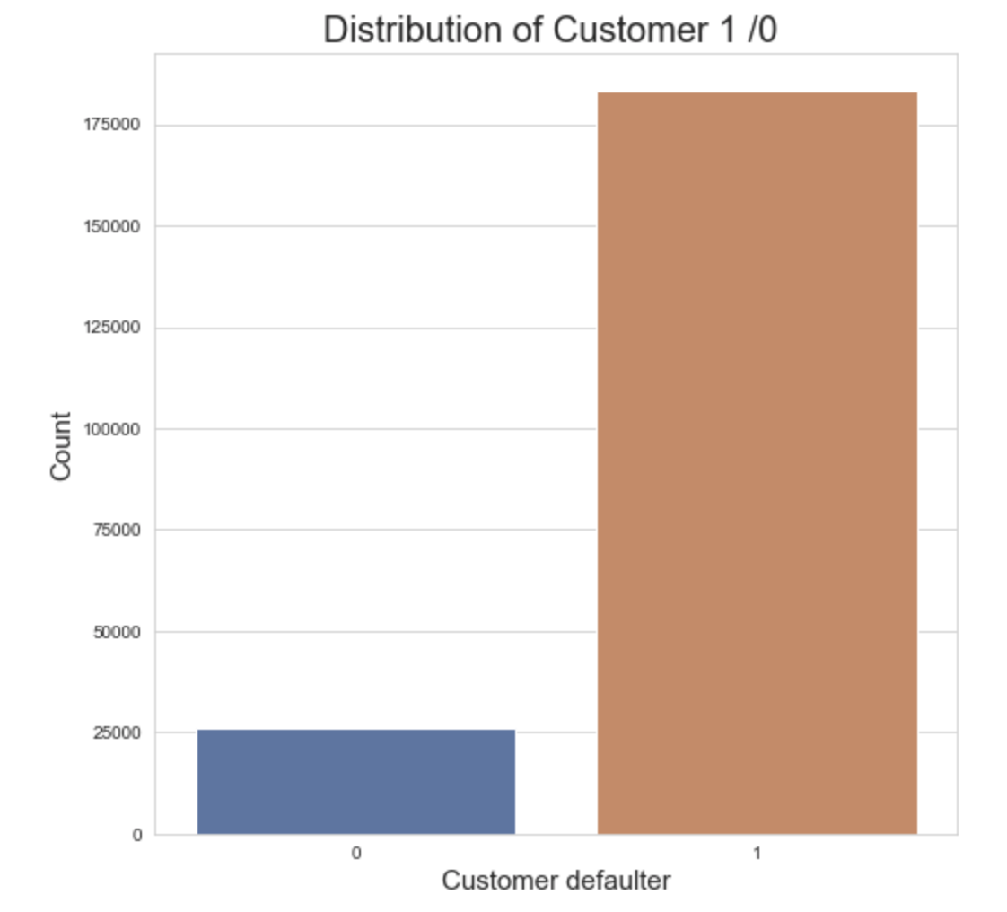
Distribution of the Target Variable

Slide 6
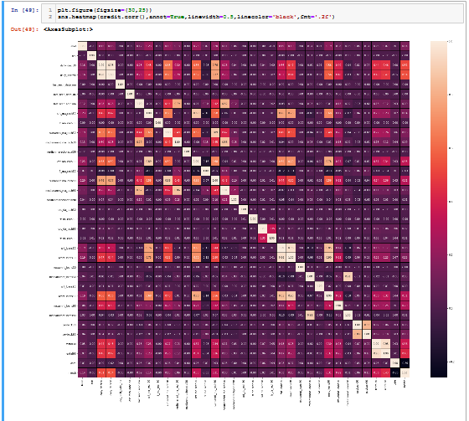
Correlation
1- We can observe that daily_decr30 and daily_decr90 have very high positive correlation with each other. 2- cnt_loan30 and amnt_loan30 also have very high positive correlation with each other. 3- We can also observe that there are many more features which have positive or negative correlation with each other. So we have to drop those columns to avoid multicollinearity
So as we can see from the above dataset, most of the column is positively correlated with the target("label")column except fr_da_rech90. At last, cnt_ma_rech90 and cnt_ma_rech30 is having highest correlation with target("label")column i.e. 0.24 AND fr_da_rech90 is having least correlation with target("label")column i.e. -0.01

Slide 7
Modelling
Model Name-
LR=LogisticRegression() DT=DecisionTreeClassifier() XGBC=GradientBoostingClassifier() RFC=RandomForestClassifier()

Slide 8
Metrics Used:
Accuracy score
Cross_val_score
Confusion Matrix
Roc_AUC_score
Classification report

Slide 9
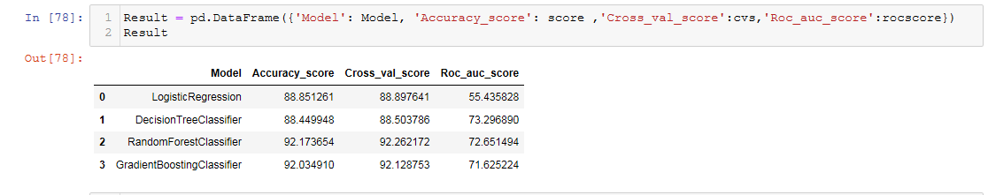
Model Score
Hyper parameter tunning for random forest classification, to enhance chosen model.

Slide 10
CONCLUSION
I am choosing here Random forest classifier model
As there accuracy_score & cross_val_score highest amongst all the modelling techniques.
Also the difference between the accuracy score and cross_val_score is same as gradient Boosting classifier
Tho auc_score is slightly more in Random forest classification.
So, I am choosing random forest classifier for further hyper tunning the model.
At last, on plot i have plotted for feature importance.

Slide 11
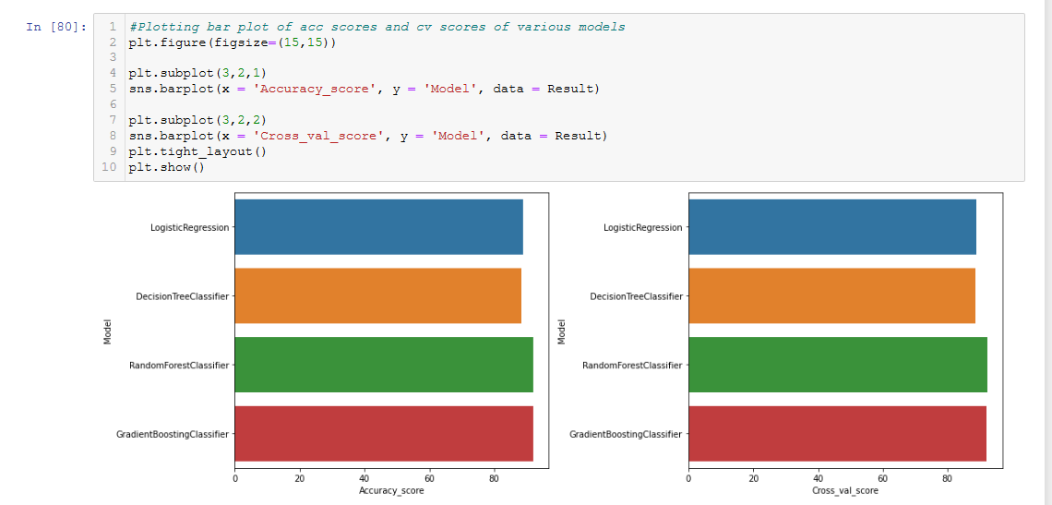

Slide 12
THANK YOU

